Slide 1
HTML Elements and Structure
By Ombugadu Priest Sabo

Slide 2
Overview
In this section you will get to know what HTML is as well as have a hands-on experience working with some basic HTML elements

Slide 3
What’s HTML
HTML is an acronym for Hypertext Markup Language which is one of the basic technology that is used in building web pages. Being a Markup language it tells your browser how to structure the web pages you visit.
All html 5 ends with a .htm or .html extension

Slide 4
HTML Tags
HTML uses various tags to define an element within a HTML document. The syntax for HTML tag is <tagname>content….</tagname>
Explanation
<tagname> is the opening tag and </tagname> is the closing tag. (Take note of the preceeding forward slash in the closing tag).

Slide 5
HTML Elements
An HTML element is usually a pair of opening and closing tag that is uniquely interpreted by the browser. Usually the opening and closing tag have same name, which denotes the HTML element’s name. Some elements however only have an opening tag without a corresponding closing tag
Example
<h1>This is an h1 element, it has a closing and opening tag</h1>
<input type="text"> <!--I don't have a closing tag-->

Slide 6
HTML Comments
Comments are piece of codes that need not be interpreted by the browser. The code are usually place within (<!–- and -->) set of characters <!–- specifies the beginning of a comment --> specifies the end of a comment
Example
<h1>This is an h1 element, it has a closing and opening tag</h1>
<!--<h1>I’m a commented heading</h1>-->
The result is, the h1 element’s content is displayed in the browser while that of the h2 element is not

Slide 7
Example of an HTML document
Listing 1
<!DOCTYPE html>
<html>
<head>
<title>First page</title>
</head>
<body>
<h1>This is my first web page</h1> <p>Writing HTML documents is fun and I hope to build the giant web page
with it</p>
</body>
</html>
Listing 1

Slide 8
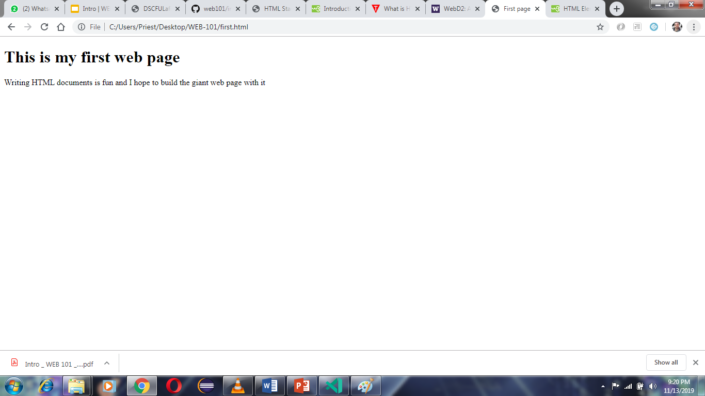
Output of Listing 1 when loaded in a browser
Listing 1

Slide 9
Anatomy of a HTML Document
Explanation to Listing 1
The <!DOCTYPE html> declaration defines this document to be HTML5, Note that, this must be present in every HTML5 document, though modern browsers are forgiving.
The <html> element is the root element of an HTML page
The <head> element contains meta information about the document
The <title> element specifies a title for the document. The title is the text you see on the window bar
The <body> element contains the visible page content
The <h1> element defines a large heading
The <p> element defines a paragraph

Slide 10
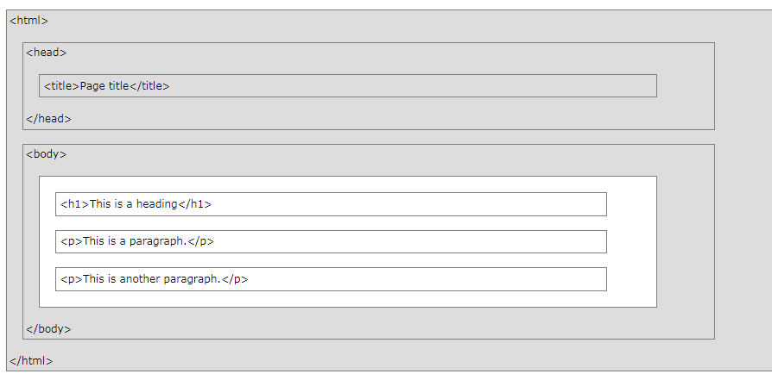
Structure of an HTML document
A visual representation of the structure of HTML document

Slide 11
The html element
The head element
This is the root element and comes immediately after the <!DOCTYPE html> declaration.
The root element contains <head> and <body> elements as its’ two direct child
This contains information about the document which are not visible to the user but used by browsers and search engines. An example is the <title> element which defines the document’s title

Slide 12
The body element
The body is usually a direct child to the root html element and it contains the visible part of an html element
From now henceforth, all markups we will be writing would be within the body element or its’ descendant(s)

Slide 13
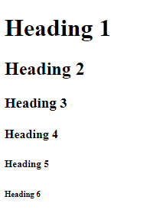
HTML headings
Headings are defined with the <h1> to <h6> tags.
Example:
<h1>Heading 1</h1>
<h2>Heading 2</h2>
<h3>Heading 3</h3>
<h4>Heading 4</h4>
<h5>Heading 5</h5>
<h6>Heading 6</h6>
Output:
<h1> headings should be used for main headings, followed by <h2> headings, then the less important <h3> and so on.

Slide 14
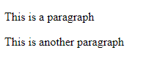
HTML Paragraphs
The HTML <p> element defines a paragraph:
Example:
<p>This is a
paragraph
</p>
<p>This is another paragraph</p>
Output:
The browser automatically strips of all whitespace and unnecessary line breaks, that’s why the first paragraph doesn’t display over multiple lines as it was in the source markup

Slide 15

HTML line break<br>
The HTML <br> element defines a line break. Use <br> if you want a line break (a new line) without starting a new paragraph:
Example:
<p>This is<br>a paragraph<br>with line breaks.</p>
Output:
NOTE: The <br>is an empty tag, i.e it doesn’t requires a closing tag

Slide 16
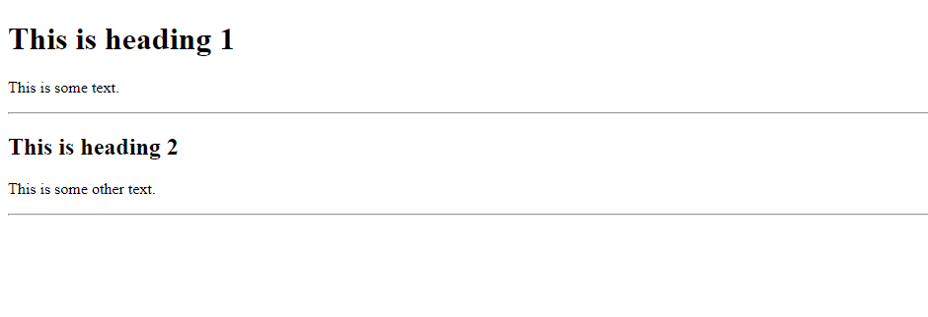
HTML Horizontal Rules <hr>
The HTML <hr> element defines a line break indicated by an horizontal rule, it’s also an empty tag.
Example:
<h1>This is heading 1</h1>
<p>This is some text.</p>
<hr>
<h2>This is heading 2</h2>
<p>This is some other text.</p>
<hr>
Output:

Slide 17
HTML Attribute
Attributes provide additional information to/about HTML elements. Attributes are always specified in the start tag are usually specified in name/value pairs like: name=“value”, though some attributes don’t requires a value
Some common attributes:
id: this is used to uniquely identify an element within an HTML document, not more than one element should have same id in a document
style: This is use to add inline style to a specific element within a page. Styles are usually specified as <property>:<value>; separated by semi-colons. E.g
<p style="color:red; background-color:black;">Red in Black</p>

Slide 18
Styling Elements
Setting the style of an HTML element, can be done with the style attribute.
The HTML style attribute has the following syntax:
<tagname style="property:value;"></tagname>
The property is a CSS property. The value is a CSS value.
Next, we will be looking at some basic CSS property, you don’t need to worry if you don’t get the whole stuff, A later part on css will expose you to the ins of css

Slide 19

Background Color
The CSS background-color property defines the background color for an HTML element.
This example sets the background color for a page to coral:
Example:
<body style="background-color:coral">
<h1>This is a heading</h1>
<p>This is a paragraph.</p>
</body>
Output:

Slide 20
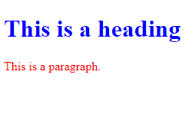
Text Color
The CSS color property defines the text color for an HTML element:
Example:
<h1 style="color:blue;">This is a heading
</h1>
<p style="color:red;">This is a paragraph.</p>
Output:

Slide 21
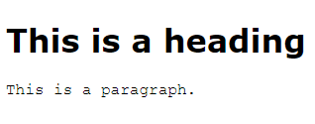
Fonts
The CSS font-family property defines the font to be used for an HTML element:
Example:
<h1 style="font-family:verdana;"> This is a heading</h1>
<p style="font-family:courier;"> This is a paragraph.</p>
Output:

Slide 22
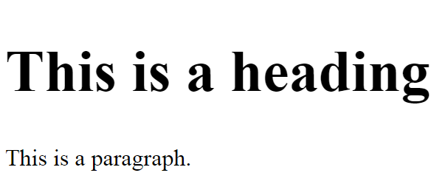
Text Size
The CSS font-size property defines the text size for an HTML element in px, %, cm, em
Example:
<h1 style="font-size:500%;"> This is a heading</h1>
<p style="font-size:2em"> This is a paragraph.</p>
Output:

Slide 23
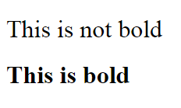
Font-weight
The CSS font-weight property defines the boldness of text content for an HTML element
Example:
<h1 style="font-weight:normal;"> This is not bold</h1>
<h1 style="font-weight:bold"> This is bold</h1>
Output:

Slide 24
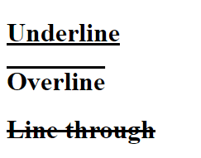
Text-decoration
The CSS text-decoration property is use to apply additional text decoration to an HTML element
Example:
<h1 style="text-decoration: underline;"> Underline</h1>
<h1 style="text-decoration: overline;"> Overline</h1>
<h1 style="text-decoration: line-through;">Line through</h1>
Output:

Slide 25
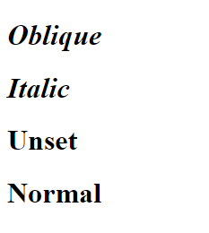
Font-style
The CSS font-style property is use to apply styling to text content of an HTML element
Example:
<h1 style="font-style: oblique;"> Oblique</h1>
<h1 style="font-style: italic;"> Italic</h1>
<h1 style="font-style: unset;">Unset</h1>
<h1 style="font-style: normal;"> Normal</h1>
Output:

Slide 26
HTML Links
HTML Links - Syntax
HTML links are hyperlinks.
You can click on a link and jump to another document.
When you move the mouse over a link, the mouse arrow will turn into a little hand.
Hyperlinks are defined with the HTML <a> tag:
<a href="url">link text</a>
url : this specifies the path to the document/object linked to
link text : this is the visible text the user can click on to move to the url, it could be text or any HTML element

Slide 27
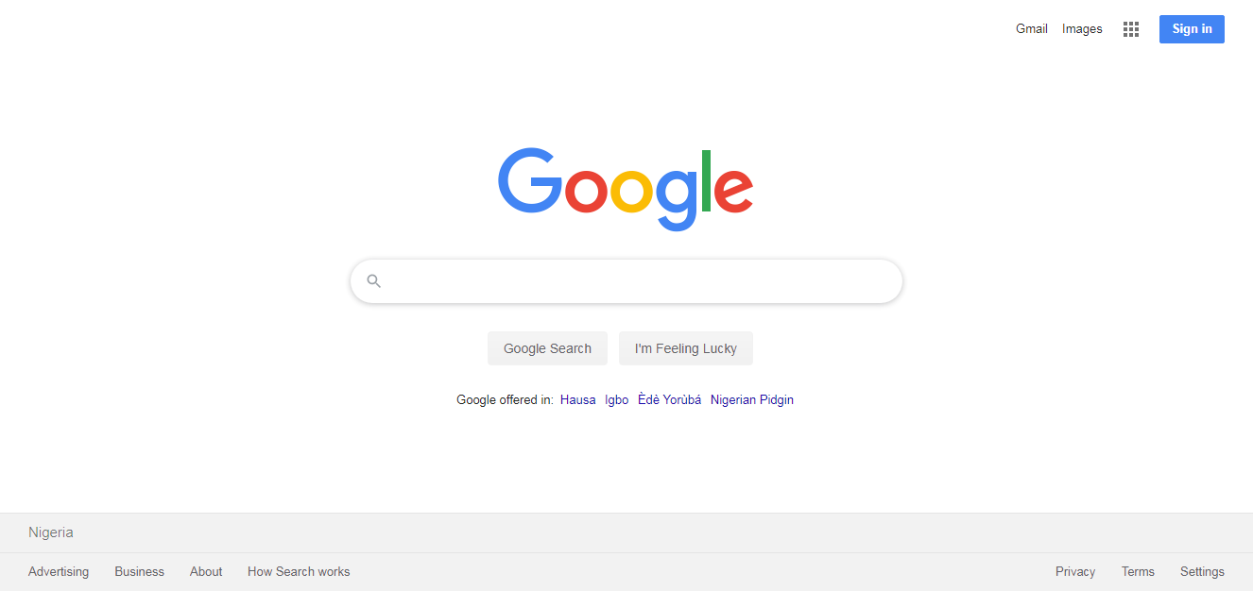
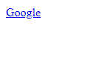
Link example
<a href="https://www.google.com">Google</a>
Output
Clicking Google, launches the page at https://www.google.com

Slide 28
Local(relative) links
These are links which points to a file relative to the current web page. The don’t’ include the protocol (http://www. , https://www. ) in the url attribute. See https://www.w3schools.com/html/html_filepaths.asp for more on links
Example:
<a href="html_images.html">HTML Images</a>
Output:
The output will be same, but will point to a file named html_images.html in the same directory as the linking file

Slide 29
HTML Links – The target attribute
The target attribute can have one of the following values:
_blank - Opens the linked document in a new window or tab
_self - Opens the linked document in the same window/tab as it was clicked (this is default)
_parent - Opens the linked document in the parent frame
_top - Opens the linked document in the full body of the window
framename - Opens the linked document in a named frame
This example will open the linked document in a new browser window/tab:
<a href="https://dscfulafia.github.io/web101/" target="_blank">Visit FULafia DSC!</a>

Slide 30
HTML Lists
In this part, we will be looking at the ordered and unordered list

Slide 31
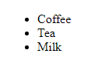
Unordered HTML List <ul>
An unordered list starts with the <ul> tag. Each list item starts with the <li> tag. The list items will be marked with bullets (small black circles) by default.
Example:
<ul>
<li>Coffee</li>
<li>Tea</li>
<li>Milk</li>
</ul>
Output:

Slide 32

Unordered HTML List - Choose List Item Marker
The CSS list-style-type property is used to define the style of the list item marker, it can take one of the following values
disc : Sets the list item marker to a bullet (default)
circle : Sets the list item marker to a circle
square: Sets the list item marker to a square
none: The list items will not be marked
Output:
Example:
<ul style="list-style-type:square;">
<li>Coffee</li>
<li>Tea</li>
<li>Milk</li>
</ul>

Slide 33
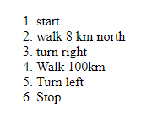
Ordered HTML List <ol>
An ordered list starts with the <ol> tag. Each list item starts with the <li> tag. This should be used if the order in which the items are arranged is important, e.g giving a direction.
Example:
<ol>
<li>start</li>
<li>walk 8 km north</li>
<li>turn right</li>
<li>Walk 100km</li>
<li>Turn left</li>
<li>Stop</li>
</ol>
Output:

Slide 34

Ordered HTML List - The Type Attribute
The type attribute of the <ol> tag, defines the type of the list item marker:, it can take one of the following values
1: The list items will be numbered with numbers (default)
A: The list items will be numbered with uppercase letters
a: The list items will be numbered with lowercase letters
I: The list items will be numbered with uppercase roman numbers
i: The list items will be numbered with lowercase roman numbers
Example:
<ol type="i">
<li>Coffee</li>
<li>Tea</li>
<li>Milk</li>
</ol>
Output:

Slide 35
HTML List - Summary
An ordered list is used when the order in which the list items matters, otherwise, an unordered list should be used

Slide 36
HTML Block and Inline Elements
Every HTML element has a default display value depending on what type of element it is.
The two display values are: block and inline.

Slide 37
Block level elements
A block-level element always starts on a new line and takes up the full width available (stretches out to the left and right as far as it can).
Example of block level elements include
<address> <article> <aside> <blockquote> <canvas> <dd> <div> <dl> <dt> <fieldset> <figcaption> <figure> <footer> <form> <h1>-<h6> <header> <hr> <li> <main> <nav> <noscript> <ol> <p> <pre> <section> <table> <tfoot> <ul> <video>

Slide 38
Inline Elements
An inline element does not start on a new line and only takes up as much width as necessary.
Example of inline elements include
<a> <abbr> <acronym> <b> <bdo> <big> <br> <button> <cite> <code> <dfn> <em> <i> <img> <input> <kbd> <label> <map> <object> <output> <q> <samp> <script> <select> <small> <span> <strong> <sub> <sup> <textarea> <time> <tt> <var>

Slide 39
The <div> Element
The <div> element is often used as a container for other HTML elements. The <div> element has no required attributes, but style, class and id are common. When used together with CSS, the <div> element can be used to style blocks of content:
Example:
<div style="background-color:black;color:white;padding:20px;">
<h2>London</h2>
<p>London is the capital city of England. It is the most populous city in the United Kingdom, with a metropolitan area of over 13 million inhabitants.</p>
</div>

Slide 40
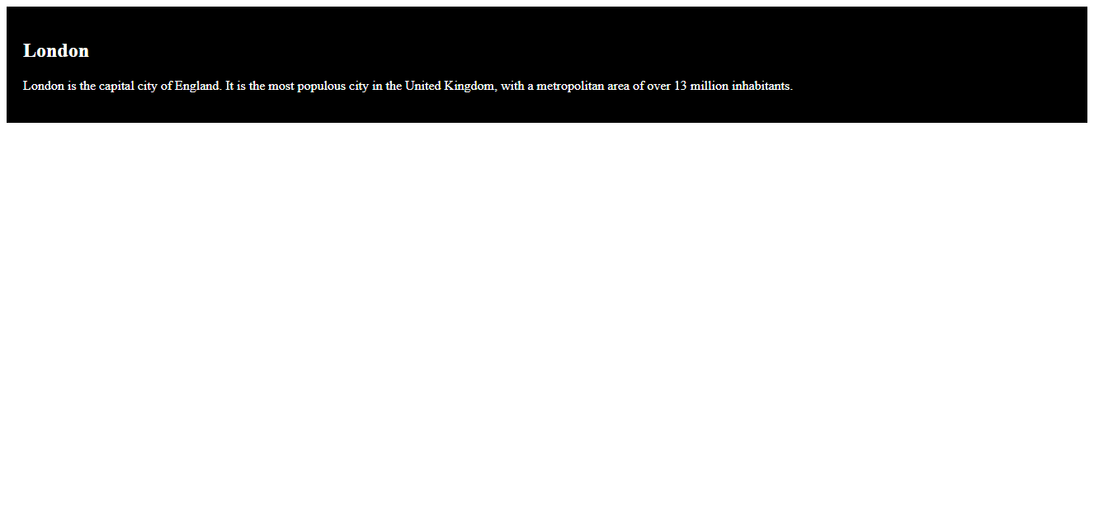
The <div> Element (cont)

Slide 41
HTML images
Syntax of HTML image
In HTML, images are defined with the <img> tag.
The <img> tag is empty, it contains attributes only, and does not have a closing tag.
The src attribute specifies the URL (web address) of the image:
<img src="url">

Slide 42
The alt Attribute
The alt attribute provides an alternate text for an image, if the user for some reason cannot view it (because of slow connection, an error in the src attribute, or if the user uses a screen reader).
The value of the alt attribute should describe the image:
<img src="img_chania.jpg" alt="Flowers in Chania">
Note: The alt attribute is required. A web page will not validate correctly without it.

Slide 43
Image example
The example below loads two images, one from and the other from same directory as the HTML document
<img src="./penguins.jpg" alt="Penguins">
<img src="https://images.pexels.com/photos/73910/mars-mars-rover-space-travel-robot-73910.jpeg?auto=compress&cs=tinysrgb&dpr=1&w=500" alt="robot">
Note: You need an internet connection for the second image to load

Slide 44

Styling the image tags.
Add the below style attribute to the above <img> tags
style="width: 250px; height: 250px"
If properly done, the output should look like the one below

Slide 45

Image as link
To use an image as a link, put the <img> tag inside the <a> tag:
<a href="https://www.google.com">
<img src="https://www.google.com/images/branding/googlelogo/2x/googlelogo_color_92x30dp.png" alt="Penguins">
</a>
Output
Clicking the image launches Google’s home page

Slide 46

The HTML <video> Element
To show a video in HTML, use the <video> element:
<video style="width:320; height:240;" controls>
<source src="https://www.w3schools.com/html /movie.mp4" type="video/mp4">
<source src="https://www.w3schools.com/html /movie.ogg" type="video/ogg">
Your browser does not support the video tag
</video>

Slide 47
Explanation to the video markup
The controls attribute adds video controls, like play, pause, and volume.
It is a good idea to always include width and height attributes. If height and width are not set, the page might flicker while the video loads.
The <source> element allows you to specify alternative video files which the browser may choose from. The browser will use the first recognized format.
The text between the <video> and </video> tags will only be displayed in browsers that do not support the <video> element.

Slide 48
HTML <video> Autoplay
To start a video automatically use the autoplay attribute:
<video style="width:320; height:240;" controls autoplay>
<source src="https://www.w3schools.com/html/movie.mp4" type="video/mp4">
<source src="https://www.w3schools.com/html/movie.ogg" type="video/ogg">
Your browser does not support the video tag.
</video>
NOTE: The autoplay attribute does not work in mobile devices like iPad and iPhone.
For more on video element check : https://developer.mozilla.org/en-US/docs/Web/HTML/Element/video

Slide 49
Task
A
Using the knowledge gained and any text editor of your choice, create the letter displayed at the url https://mdn.mozillademos.org/files/15811/Letter%20screengrab%202.png. You can use https://www.w3schools.com/html/ as reference while completing the task. Good Luck.
Zoom your browser to have a better view of the image

Slide 50
Thank You!

